Slide 1
Retail Bank CNP Fraud Detection — Business Deck
Presented by: Patrick Evan G Arriola Date: Dec 24, 2025 Repository: https://github.com/patrickearriola-max/Pat-Arriola-Fraud-Capstone

Slide 2
CNP Fraud Prevention — Executive Brief
Channel: card‑not‑present e‑commerce (PH).
Goal: ≥20% fraud loss reduction with ≤1% FPR.
Operate under alert budget & guardrails; maximize Expected Value (EV)

Slide 3
Problem & Objective
Rising chargebacks; limited Ops capacity (≈500 alerts/day).
Cut fraud loss while protecting CX and investigator load.
Decision policy: pick threshold τ that maximises EV subject to FPR≤1% or alert budget.

Slide 4
What We Built
Real‑time transaction scoring (0–1).
Models: Logistic (balanced), Random Forest, XGBoost (scale_pos_weight).
Temporal validation (80/10/10 ordered by Time); leakage‑safe features.

Slide 5
Data Snapshot
≈285k txns; fraud ≈0.17%.
Features: V1–V28 + Amount_log, Amount_rz, Time_sin, Time_cos.
Temporal split: 80% train / 10% val / 10% test.
Split | Rows | Fraud | Rate
Train | 227,846 | 417 | 0.183%
Val | 28,480 | 53 | 0.186%
Test | 28,481 | 22 | 0.077%
Overall | 284,807 | 492 | ≈0.173%

Slide 6
Key Results — Validation
EV at tight FPR: RF @ FPR≈0.17% → EV ≈ ₱107k (test), ~65 ≈alerts, Precision ≈25 %., Recall ≈73%,
Under K=65 (test): Precision ≈25%, Recall ≈73%, FPR ≈ 0.17%EV ≈ ₱107k.
EV declines as K increases; tune τ to Ops capacity and CX guardrails.

Slide 7
Summary of key results
With a tight false-positive cap, Random Forest delivers the strongest financial outcome. Features: V1–V28 + Amount_log, Amount_rz, Time_sin, Time_cos.
If we constrain reviews, we still keep high fraud coverage (recall=0.727) and raise precision to ~25%; EV remains in the ₱107k range, so we can tune the threshold to fit Ops capacity without giving up much value.
EV falls as alerts increase, so we operate at an FPR cap or K-budget, whichever best protects customer experience while meeting risk goals.

Slide 8
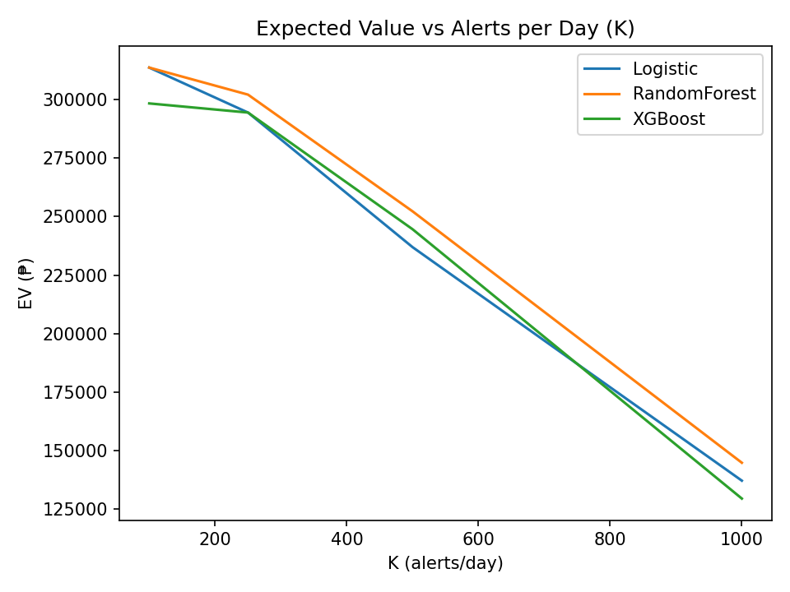
Trade‑off: EV vs Alerts Budget (K)
Note: Final operating point is selected via FPR-constrained thresholding (τ), yielding 65 alerts; this chart shows fixed-K alternatives for capacity planning.
We evaluated two policies: a fixed-K policy for capacity planning, and a threshold policy constrained by FPR. The deployed point uses the FPR-constrained threshold, which resulted in 65 alerts on the test window. The K-sweep chart illustrates trade-offs if operations want to force higher alert volumes.

Slide 9
Key Results — Test (Hold‑out: TEST)
Operation point Chosen on validation under FPR Cap of <=0.5% applied to Test.
Test: ~65≈alerts | Precision ≈25% | Recall ≈73% | FPR ≈0.17%.
Expected Value on the test: ≈ ₱107k (scales with volume).

Slide 10
Operational & Customer Impact
Workload: configurable 65–250 alerts/day in initial rollout scenarios.
CX: FPR cap ≤1% limits unnecessary reviews/declines.
Savings: more early‑stage CNP attacks intercepted at controlled cost.

Slide 11
Governance, Risk & Reproducibility
Drift monitoring (PSI) + monthly threshold recalibration.
Fairness slices (amount/hour) monitored; route thresholds if needed.
Repo with saved reports/figures & requirements; deterministic temporal splits.
Latency target ≤300 ms; RF/XGB feasible.

Slide 12
Summary of Governance, Risk & Reproducibility
Watch for change (drift): Fraudsters adapt. A simple stability check (PSI) tells us when the data shifts so we can reset thresholds monthly. Why? To avoid missing new fraud patterns or over-flagging good customers.
Check fairness by slices (amount/hour): We track where alerts cluster and where precision drops. Why? To reduce customer complaints and regulatory risk, and we can route or tighten thresholds in low-precision slices.
Make it repeatable (repo + audit trail): All figures, reports, and package versions are saved with deterministic time-based splits. Why? Anyone can re-run results on demand, speed reviews, and prove nothing “moved” between testing and go-live.
Be fast (≤300 ms): Random Forest/XGBoost meet real-time needs. Why? So we block fraud without slowing checkout, protecting revenue and customer experience.

Slide 13
Recommendation
Adopt Random Forest with τ tuned for FPR≈0.5% for Phase‑1 pilot.
Weekly precision review; adjust τ toward EV optimum within guardrails.
QA‑sample low‑precision slices; prepare drift/fairness dashboards.

Slide 14
Recommendation
Start at the tested operating point (Alerts=65 in the evaluation window; scales with traffic) and expand toward 150–250 only if precision holds.
This setting caught the most fraud for the money in validation without swamping investigators or annoying good customers with false alarms.
Review precision weekly and nudge the threshold.
Fraud patterns and volumes move. Small, controlled tweaks keep us on the best value point (highest expected savings) while staying inside our guardrails (≤1% FPR or the agreed alert budget).
Spot-check “low-precision” pockets and add simple dashboards.
Quick QA on slices like small amounts or specific times of day trims false positives fast. Drift/fairness dashboards let us see pattern shifts early and recalibrate monthly before performance slips.
Pilot success = measurable impact and manageable workload.
We graduate from pilot when we cut fraud losses by ≥20% and keep investigator load and customer friction in line with the targets above.

Slide 15

Rollout Plan (4–6 weeks)
Week 1–2: package + shadow test; finalize alert workflow.
1
Week 3–4: pilot at K=65-100; track precision/recall/FPR/EV; calibrate τ.
2
Week 5–6: expand to K=150–250 if precision ≥ target; handoff runbook.
3

Slide 16
Roll Out
Weeks 1–2 — Package & shadow test
We wrap the model and run it quietly alongside production to confirm data feeds, latency (<300 ms), and alert formatting. We de-risk and go-live and catch integration issues before any real decisions are made.
Weeks 3–4 — Pilot at K=65 to 100 alerts/day; calibrate τ.
We send ~ up to 100 highest-risk alerts/day to Fraud Ops, track precision, recall, FPR, and EV, and adjust the threshold τ to hit guardrails (e.g., FPR ≤1%) while maximizing value. We prove the business case on a small, controlled load and tune for your reality.
Weeks 5–6 — Expand to K=150–250 if precision meets target; handoff runbook.
If pilot precision holds, we lift capacity in steps and finalize the runbook (SLA, escalation, retraining/PSI checks, dashboard links). We scale responsibly, protect CX, and leave Ops with a clear, repeatable process.

Slide 17
Next Steps
Enable Evidently PSI + fairness dashboards; add latency micro‑benchmark.
Explore enrichment (device/merchant velocity); auto‑tune τ by Ops capacity.
Prepare business‑facing comms for CX/Policy; align go‑live KPIs.

Slide 18
Next Steps
Switch on monitoring. Enable Evidently dashboards for data drift and fairness by slice and add a quick latency check. Spot pattern changes early, catch uneven performance, and make sure decisions stay fast.
Enrich and auto-tune. Explore adding device/merchant velocity features and auto-tune the threshold (τ) to the team’s capacity. Improve fraud catch rate without flooding analysts; keep alert volumes in the “green.”
Prep go-live comms & KPIs. Align with CX/Policy on customer messaging, escalation rules, and success metrics for rollout. Smooth launch, fewer surprises for customers, and clear accountability on outcomes.

Slide 19
END

